Slide 1
Our 2024-2029 Mission Engagement Toolkit
#EUImmunisationStrategy
12 February 2024

Slide 2
Introduction

Slide 3
Towards an EU Immunisation Strategy
Through its EU elections campaign, Vaccines Europe aims to ensure that immunisation is prioritised as a key public health priority in the next mandate.
At the core of the campaign, our manifesto outlines our key policy priorities for the 2024-2029 mandate in detail, outlining how an EU Immunisation Strategy can help build an innovative, healthy and prosperous Europe.
We invite our partners, interested civil society organisations, policymakers and individual supporters to get involved in the campaign.
In this deck, you will find a list of concrete suggestions on how you/your organisation can contribute to making the EU Immunisation Strategy a reality.
For any questions, please contact laurent.louette@vaccineseurope.eu.

Slide 4
How you can support
1. Align messaging
Incorporate the key messages and policy asks into meeting briefings, speaking points, speeches
Utilise your channels (website, SoMe, newsletters, etc.) to disseminate key messages and asks
3. Involve network for endorsement
Reach out to relevant contacts to introduce them to the campaign and encourage them to support and leverage the asks
2. Engage and communicate
Ensure that your colleagues are informed to do the same
Inform Vaccines Europe that you want to be added as a supporter on the website
Set up meetings with relevant stakeholders to discuss the elections
Engage around party congresses and respond to stakeholder consultations organised by parties

Slide 5
In this deck
Key messages
With this messaging overview, you will be able to easily incorporate the key asks of the elections campaign into your ongoing work.
Campaign materials
To support your external engagement, please find here an overview of all available materials (online and printed), as well as ready-to-use social media packs.
Timeline and key milestones
This snapshot has been developed to provide an overview of the main changes that the elections will bring and of the most important milestones to engage around.

Slide 6
Key messages

Slide 7
Overarching messages
Our mission is an innovative, healthy, and prosperous Europe. It’s time to put in place a comprehensive EU Immunisation Strategy that strengthens protection across all generations, towards a more resilient EU.
Given the major challenges the EU is facing today, it is easy to overlook how important a strong immunisation policy is. However, many of the crises we face are interconnected with infectious diseases. Immunisation must be at the heart of building more resilient and sustainable health systems.
By strengthening immunisation policies, we can enable a framework for better coordination and transparent collaboration among stakeholders, ensure adequate resource allocation and utilisation, bridge existing disparities and foster equitable access to and uptake of vaccines.

Slide 8
Policy asks
We call on EU policymakers to put in place an EU Immunisation Strategy, building on the following three pillars to build a Europe that is innovative, healthy and prosperous:
Innovative
Healthy
Prosperous
Message: Vaccine innovation helps us to be one step ahead of public health threats. Let’s promote policies that foster innovation and strong stakeholder collaboration as part of a new EU Immunisation Strategy, to expedite access to existing and new vaccines and ensure crisis preparedness.
Message: Life-course immunisation targets at the EU level can contribute to more equitable vaccine uptake and protection for the entire European population, and will help us all to lead safer, healthier and more productive lives.
Message: Investing in immunisation pays off. Yet, today, a very small part of national healthcare budgets goes to prevention. It’s time to introduce financial targets to improve funding for immunisation programmes across Europe.
Ask: Promote forward-thinking policies that foster innovation and establish a framework for regular exchange between all relevant stakeholders, including the vaccines industry
Ask: Set and monitor life-course immunisation targets
Ask: Set EU appropriate financial targets to improve national investments in immunisation programmes

Slide 9
Timeline & key milestones

Slide 10
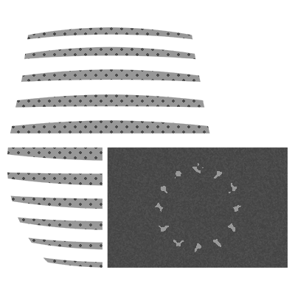
Impact of the elections
720 European Parliament seats up for grabs
New party priorities and pledges set out in election manifestos
Appointment of a new Commission President and new Commissioners
Potential impact on DG leadership
New Commission agenda and mission letters for each new Commissioner
Appointment of a new European Council President
European Council Strategic Agenda

Slide 11
High-level timeline overview
Party manifesto drafting
Q2 to Q1 2024
Parties publish manifestos and select Spitzenkandidaten
Q1 2024
First new Parliament plenary
Jul 2024
European Council Strategic Agenda published
Jun 2024
Final plenary
Apr 2024
Deadline for
new proposals
May 2023
New Commission takes office after EP hearings; Mission Letters sent
Dec 2024
Campaign period
Elections
6-9 June 2024
Post-election period
Q1 2023
Q2
Q3
Q4
Q1 2024
Q2
Q3
Q4

Slide 12
Key milestones*
EU elections
6-9 June 2024
SEP | OCT | NOV | DEC | JAN | FEB | MAR | APR | MAY | JUN
Manifesto input
Manifesto drafting
Manifesto decision phase and finalisation
Congress (6-7 Mach) in Bucharest. Adoption of Manifesto and election of Spitzenkandidat
Possible stakeholder consultation (tbc - no consultation conducted to date)
Congress in Malaga (10-11 Nov), adoption of resolution to feed into manifesto
Congress (2 March) in Rome. Adoption of Manifesto and election of Spitzenkandidat
Manifesto development by Secretariat with input from stakeholders and national parties
Congress (20-21 March, Brussels). Adoption manifesto will be adopted and Spitzenkandidat elected
Manifesto development by Manifesto Drafting Committee
Congress (2-4 Feb)
in Lyon.
Adoption of Manifesto and election of Spitzenkandidaten
Manifesto development by Editorial Working Group, guided by EU member parties and civil society partners
* This slide covers the four largest political formations during the 2019-2024 mandate.

Slide 13
Campaign materials

Slide 14
Overview of available materials
Online
Vaccines Europe elections website
Manifesto brochure (PDF)
Social media materials (see next slides)
Printed
Booklet
Manifesto in a box

Slide 15
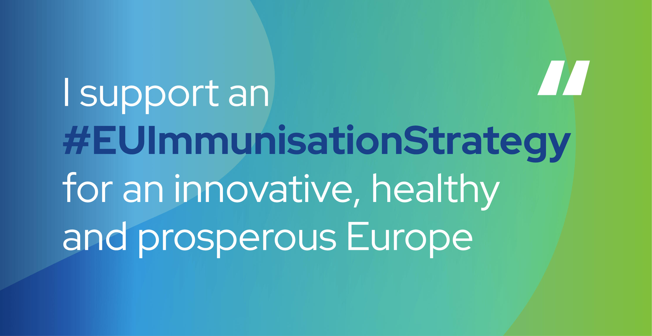
Social media pack
Twitter/X | LinkedIn | Suggested visual
Through immunisation, the spread of many diseases has been curbed or significantly reduced, making Europe healthier and more prosperous. There is still more we can do to unlock the full potential of immunisation. It is time for an #EUImmunisationStrategy. | Thanks to immunisation, the spread of many vaccine-preventable diseases across Europe and in the world has been curbed or significantly reduced, saving lives and easing the pressure on our healthcare systems. However, there is still more we can do to unlock the full potential of immunisation, through improved stakeholder collaboration and EU-level targets. It is time for an #EUImmunisationStrategy
In the next mandate, I support an #EUImmunisationStrategy to help: ✅ Foster more equitable access to immunisation ✅ Improve our readiness to address new public health threats ✅ Ease pressure on our healthcare systems | With the various major challenges facing the EU, it is easy to overlook the importance of strong immunisation policies. However, prevention through immunisation remains essential. Many of the challenges we face today are interconnected with the spread and rise of existing and new infectious diseases. In the 2024-2029 mandate, I will support an #EUImmunisationStrategy which would aim to: ✅ Foster more equitable access to immunisation ✅ Improve our readiness to address new public health threats ✅ Ease pressure on our healthcare systems | Quote card (see slides 17/18).

Slide 16
Social media pack
Twitter/X | LinkedIn | Suggested visual
We have seen the benefits of immunisation in improving health in the EU and the world. Looking ahead at the next mandate, join me in supporting an #EUImmunisationStrategy! | We have seen the benefits of immunisation in improving health in the EU and the world, not only in the fight against pandemics but also in eradicating and significantly reducing various diseases. Looking ahead at the next mandate, join me in supporting an #EUImmunisationStrategy! | Any visual from the toolkit.
It’s time for an #EUImmunisationStrategy! Increased and more equitable uptake of immunisation is essential for an innovative, healthy and prosperous Europe. | In the 2024-2029 mandate, it’s time for an #EUImmunisationStrategy! Increased and more equitable uptake of immunisation in all member states is essential for an innovative, healthy and prosperous Europe. | Any visual from the toolkit.
Tips & tricks for engagement:
Tag Vaccines Europe and partner organisations in your posts: online discourses perform well in a cluster
Adapt the posts to your specific needs – a tailored touch can make sure that the issues most relevant to you are publicly salient
Please use the #EUImmunisationStrategy as it ties the campaign together.

Slide 17
We need an EU Immunisation Strategy because…
John Smith
Title, Organisation

Slide 18
We need an EU Immunisation Strategy because…
John Smith
Title, Organisation

